Slide 1
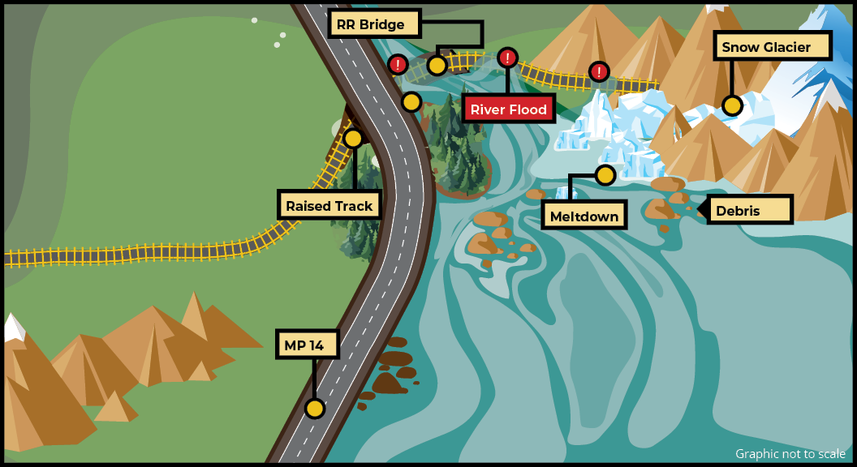

Seward MP 14 Railroad Crossing
WELCOME!
Project Update
May 29, 2025 | 5-7PM
Photo Caption
Notes:
Rori
Welcome
Thank you

Slide 2


Meet the Project Team
DOT&PF
Rori Van Nortwick, PE
Project Manager
Patty Homerding
Designer
Greg Hartman, PE
Project Manager
Donald Handeland, PE
Transportation Engineer
Tatjana Spaic, PE
Transportation Engineer
Beth Steele, EIT
Transportation Engineer
Pearl-Grace Pantaleone
Public Involvement
Notes:
Rori

Slide 3
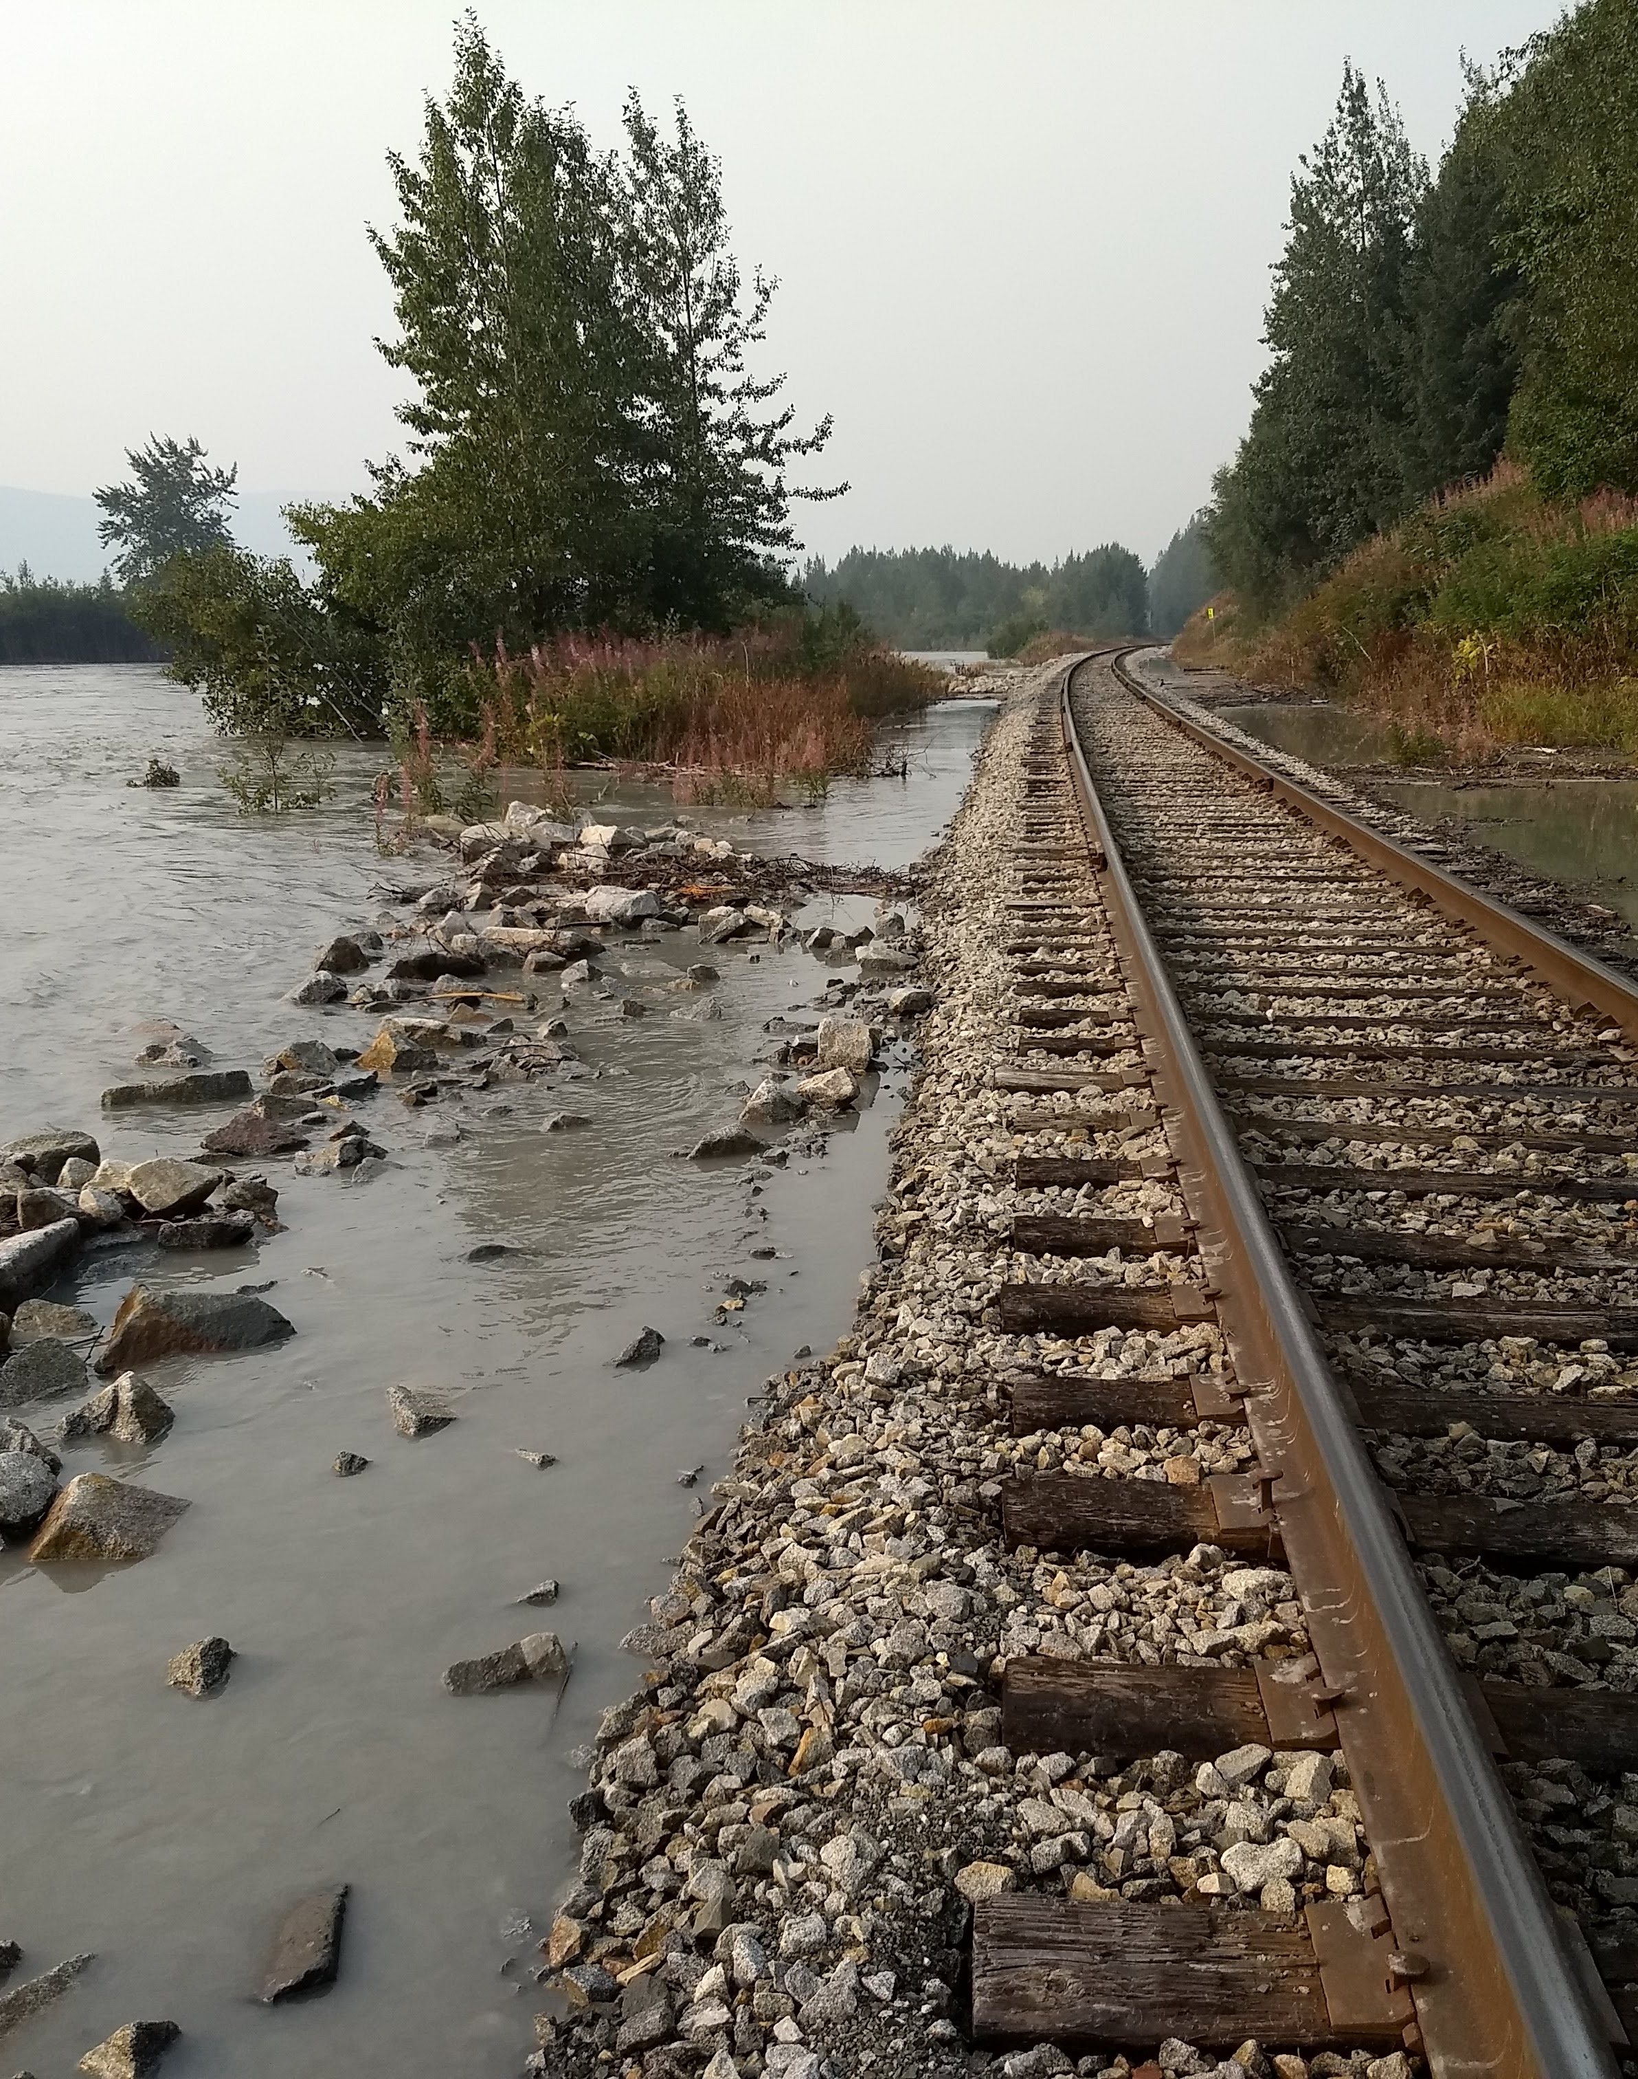
Agenda
Project Overview
Why This Project?
What Are We Doing?
How Are We Doing It?
When Are We Doing It?
Poster Session / Individual Q/A
Notes:
Rori

Slide 4
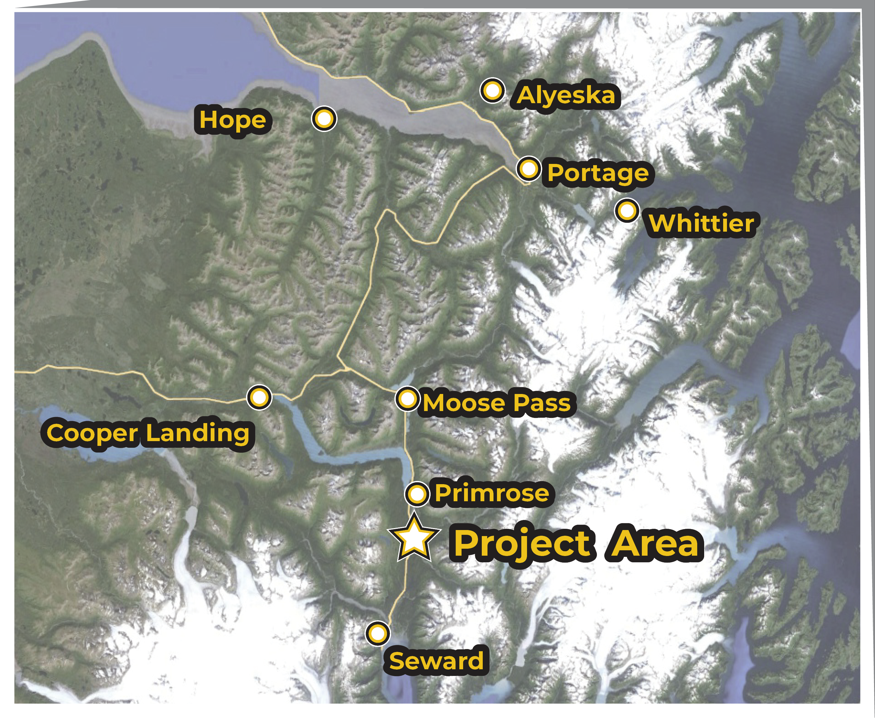
Project Overview: Area Map
Milepost (MP) 14
Near Snow River
Notes:
Greg

Slide 5
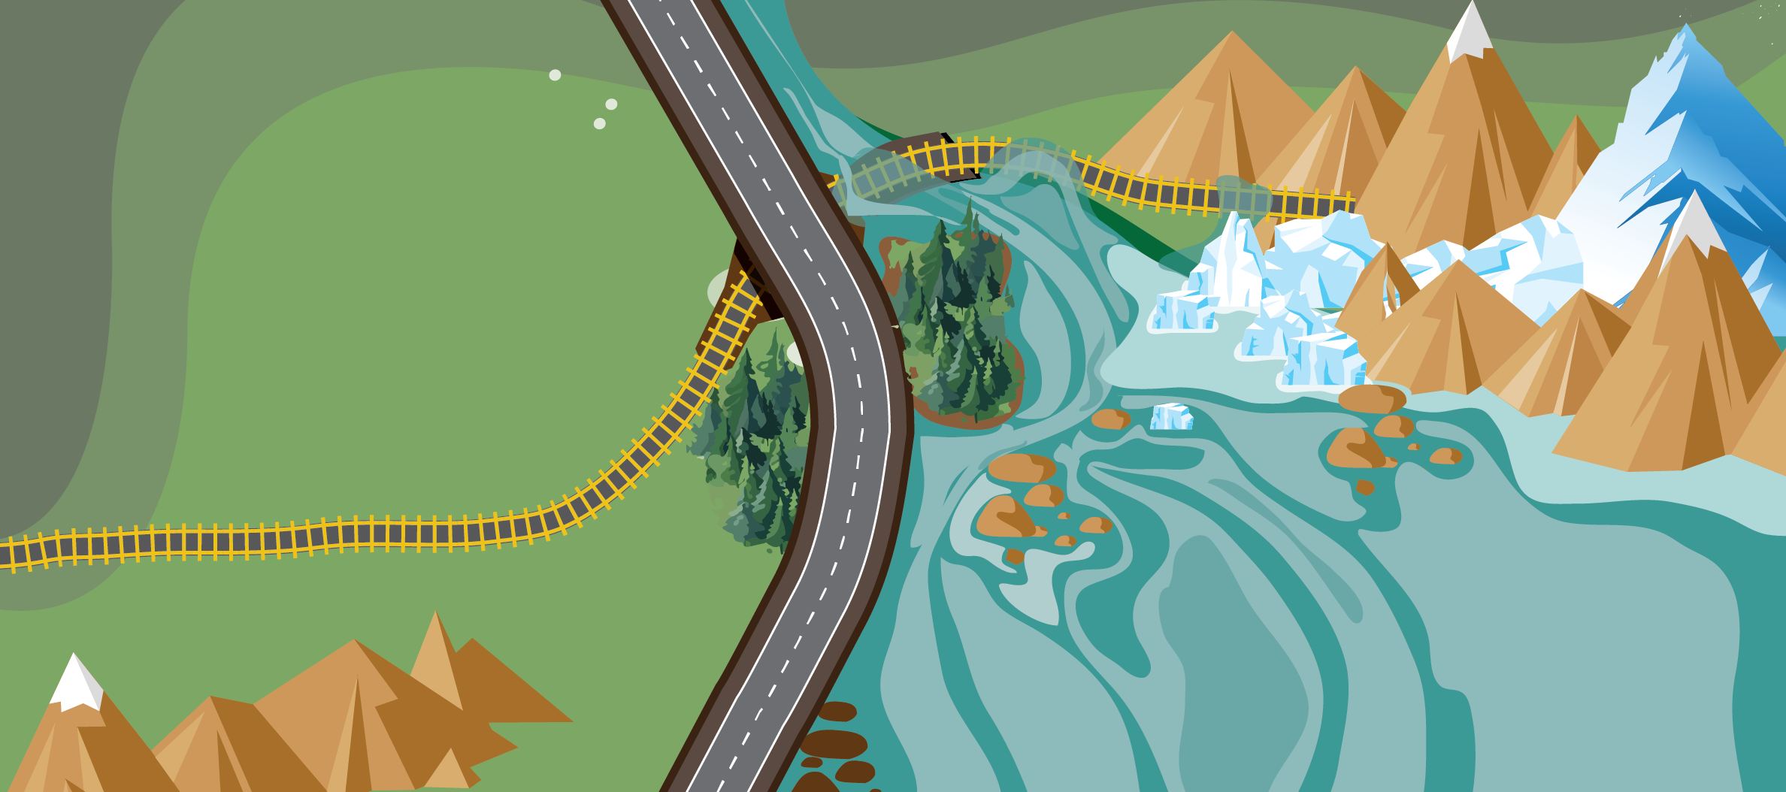
Project Overview: History
Jökulhlaup
[yo-KOOL-lahp]
Notes:
Greg

Slide 6
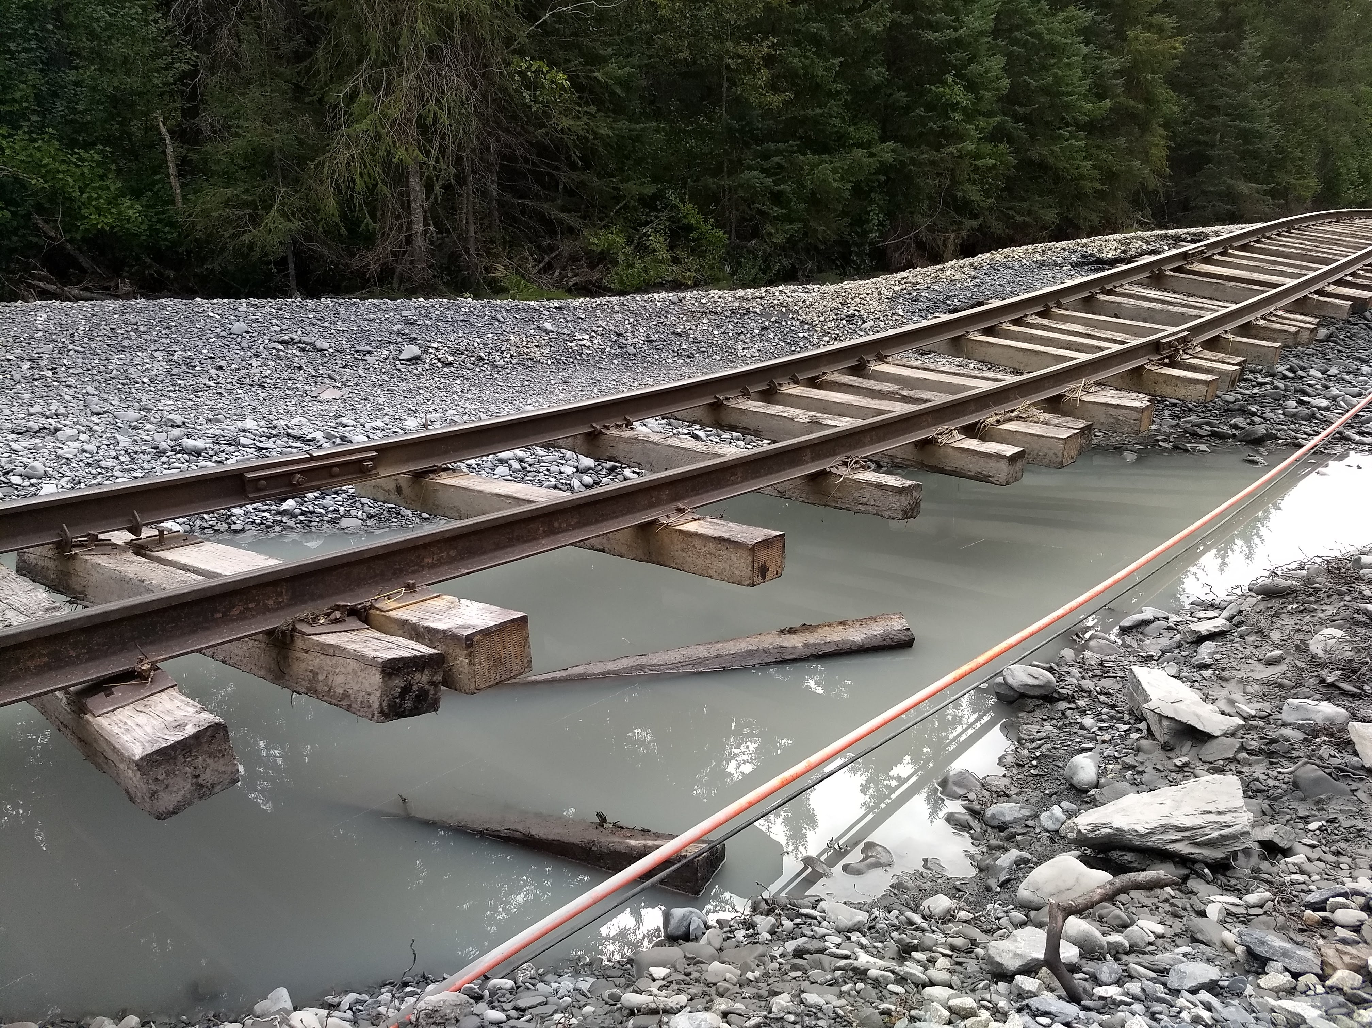
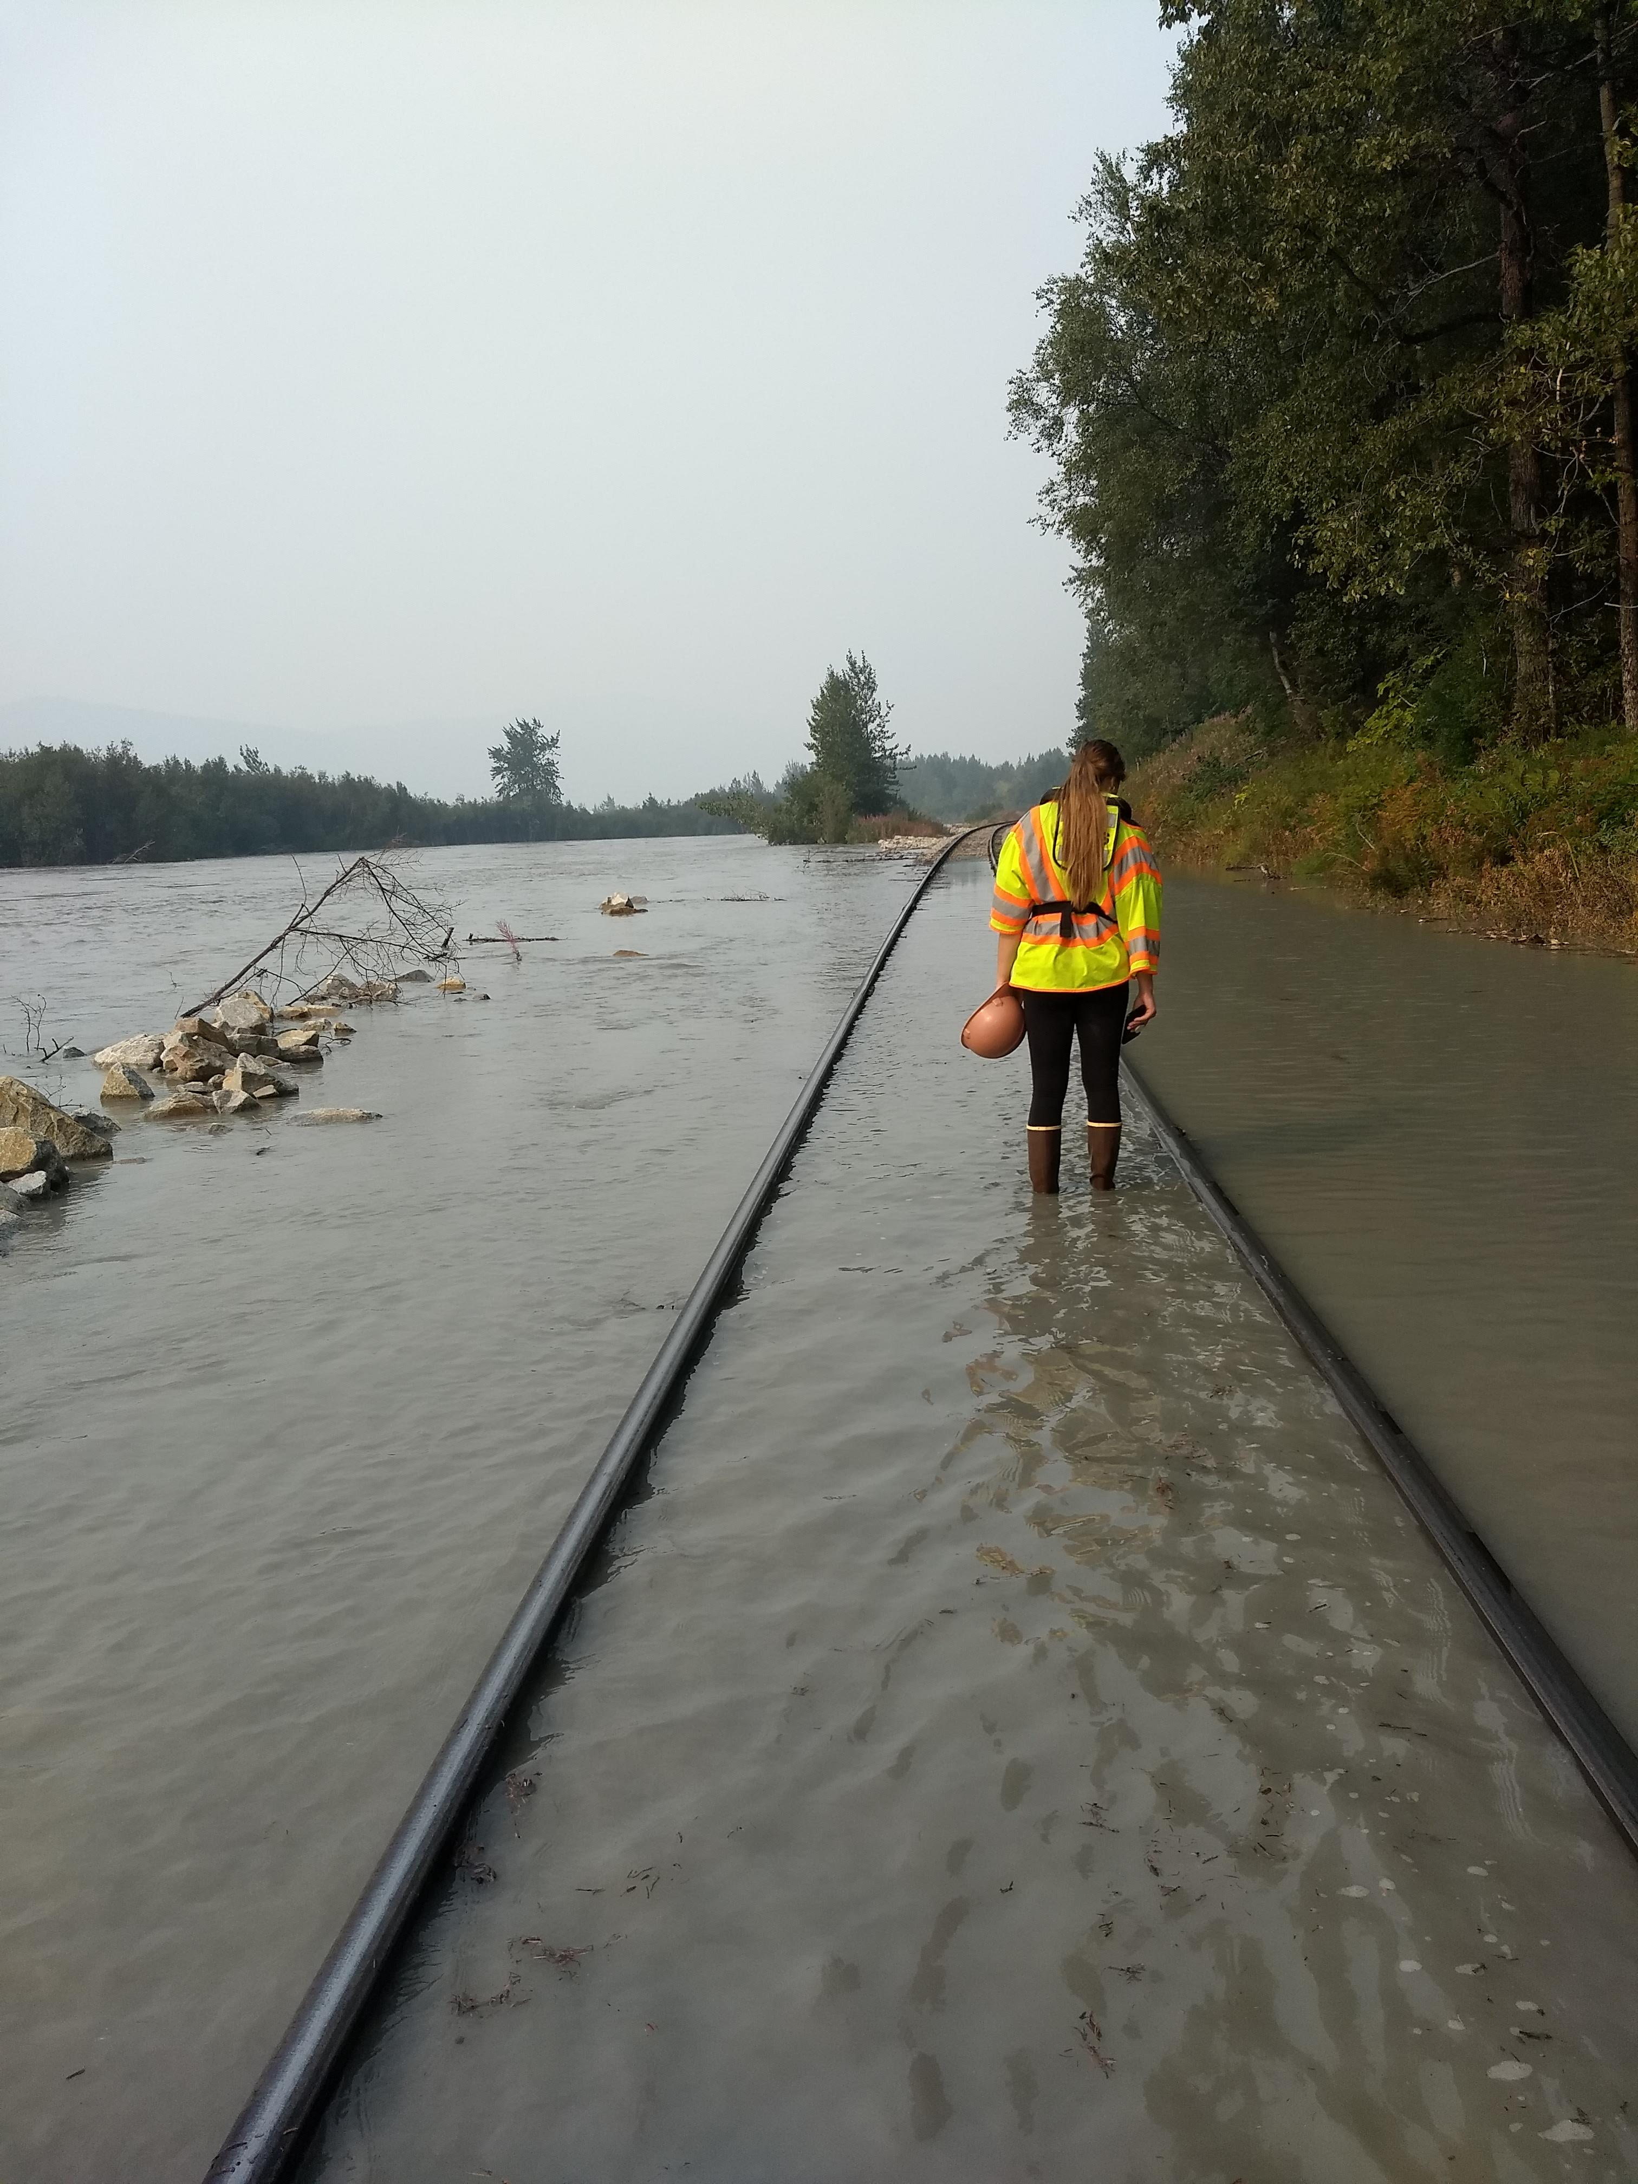
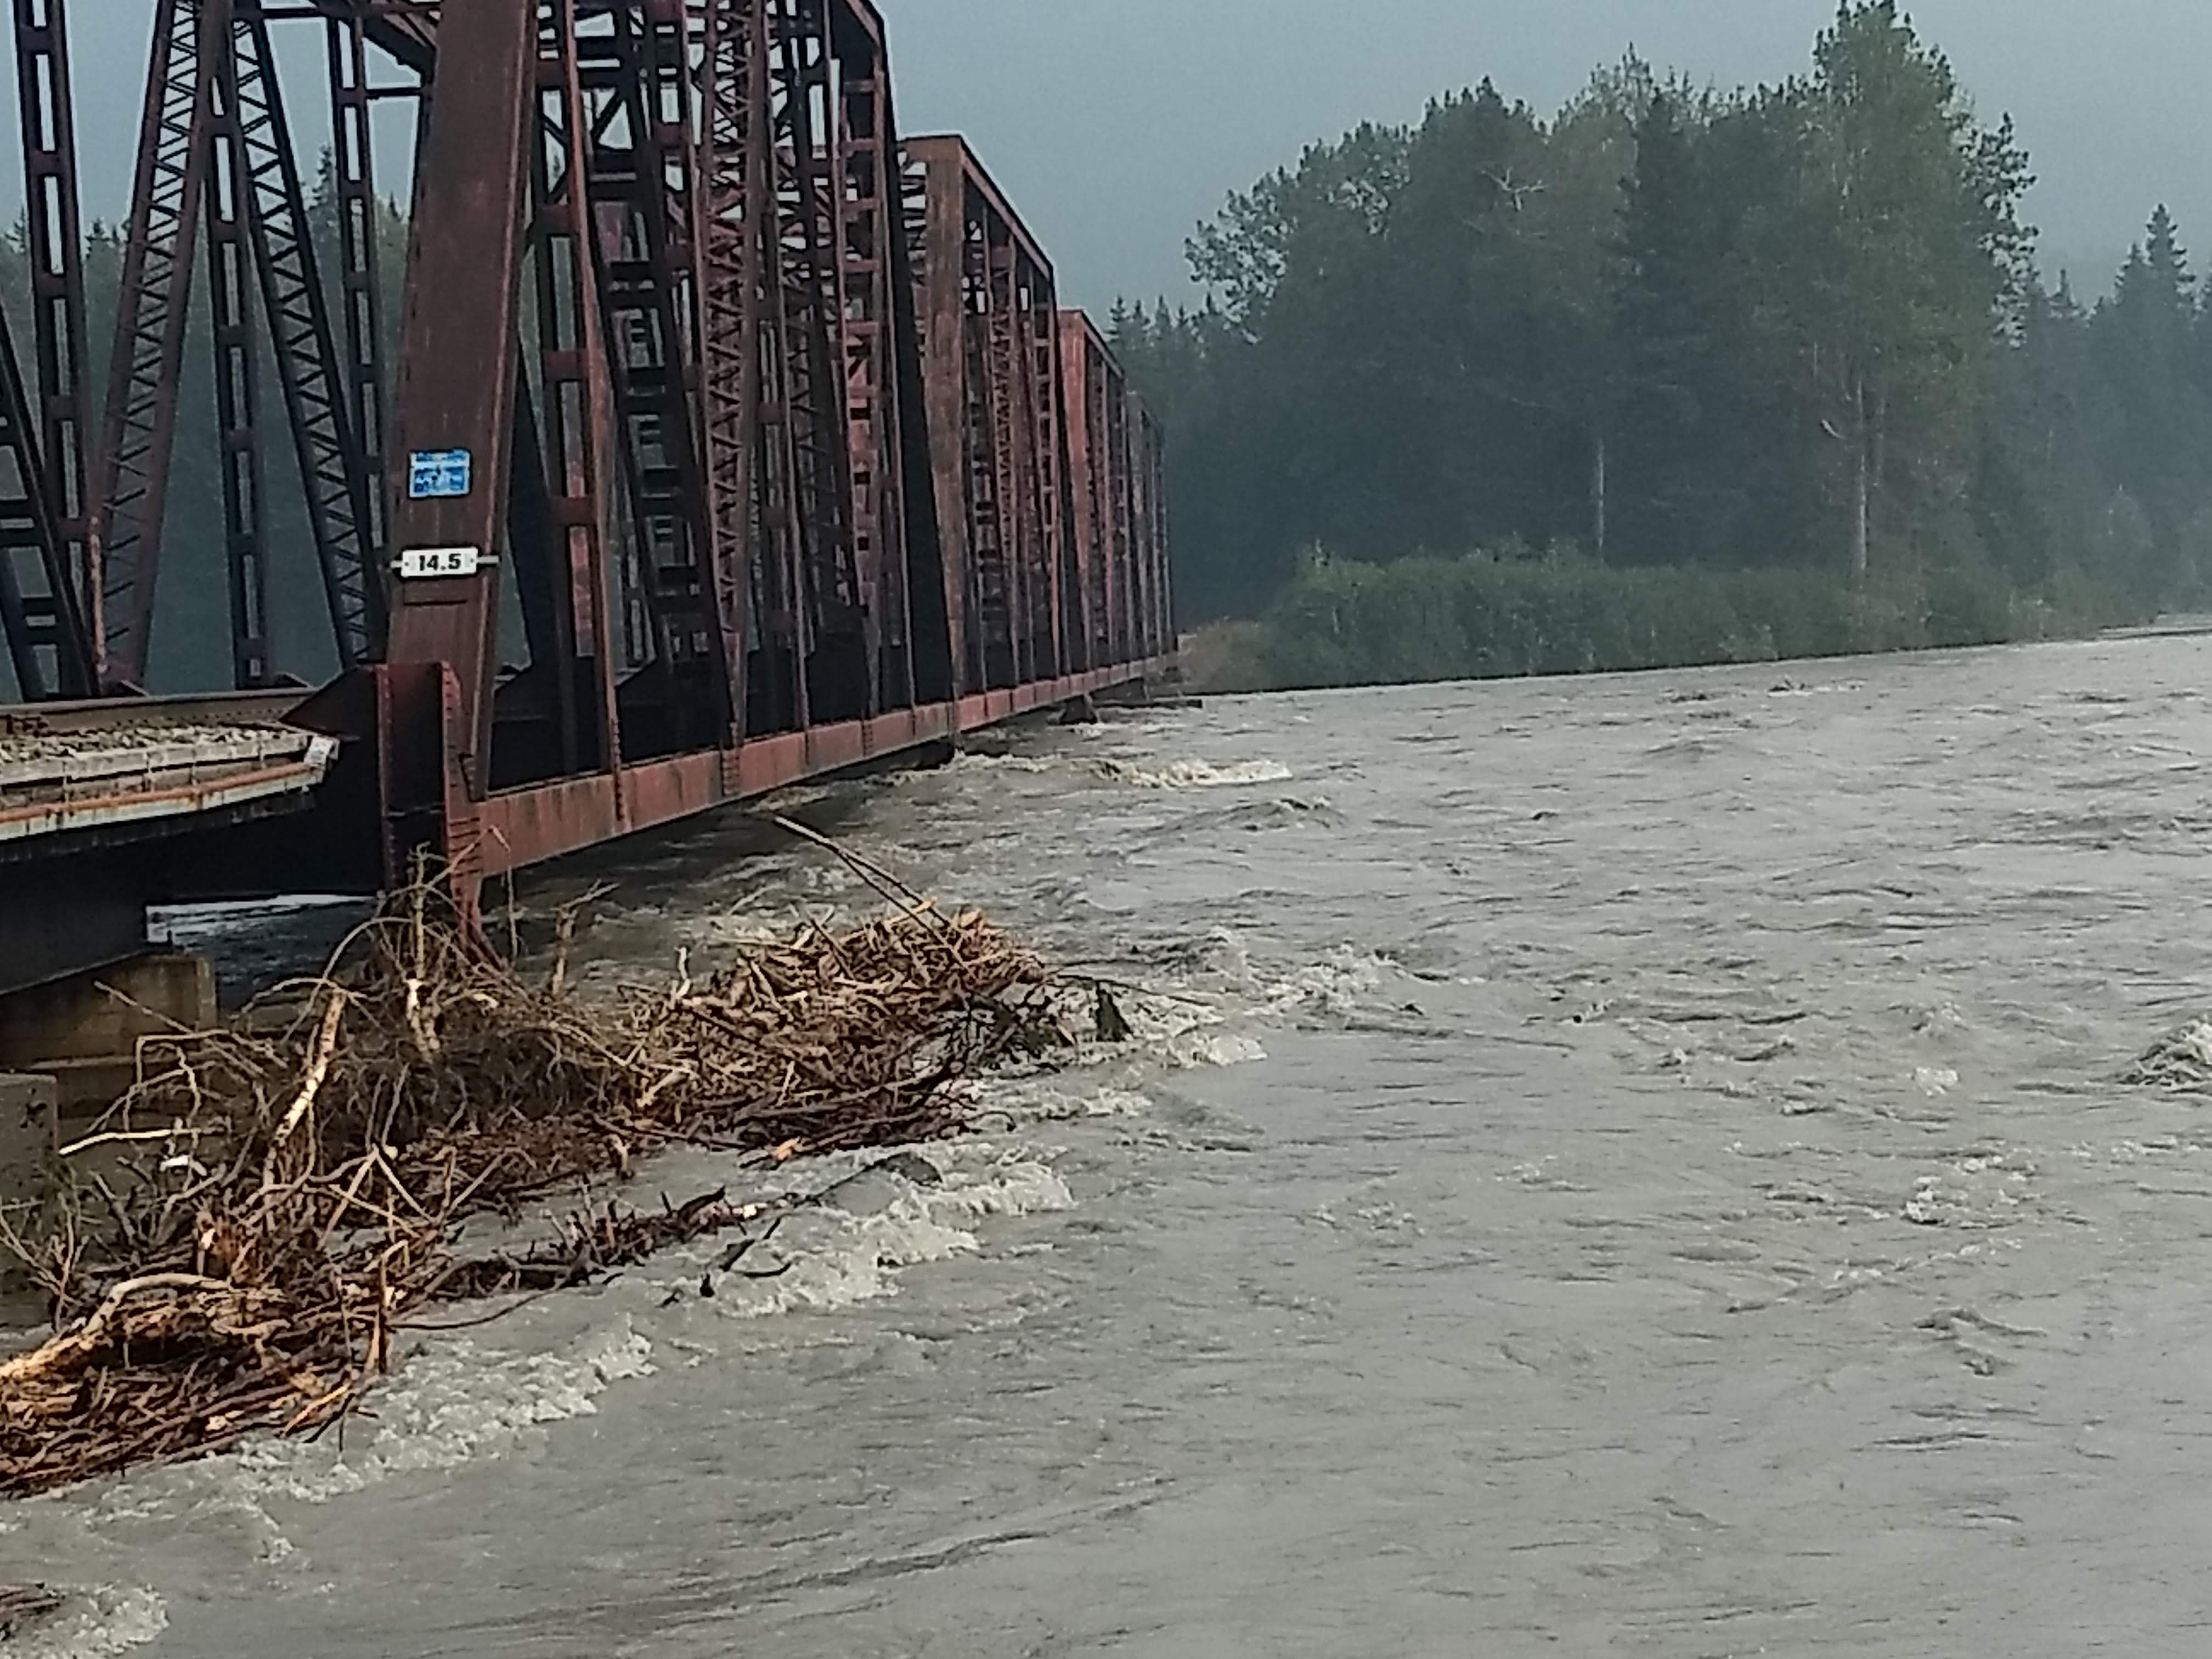
Damaged Tracks
Notes:
Greg
Look up dates on photos

Slide 7
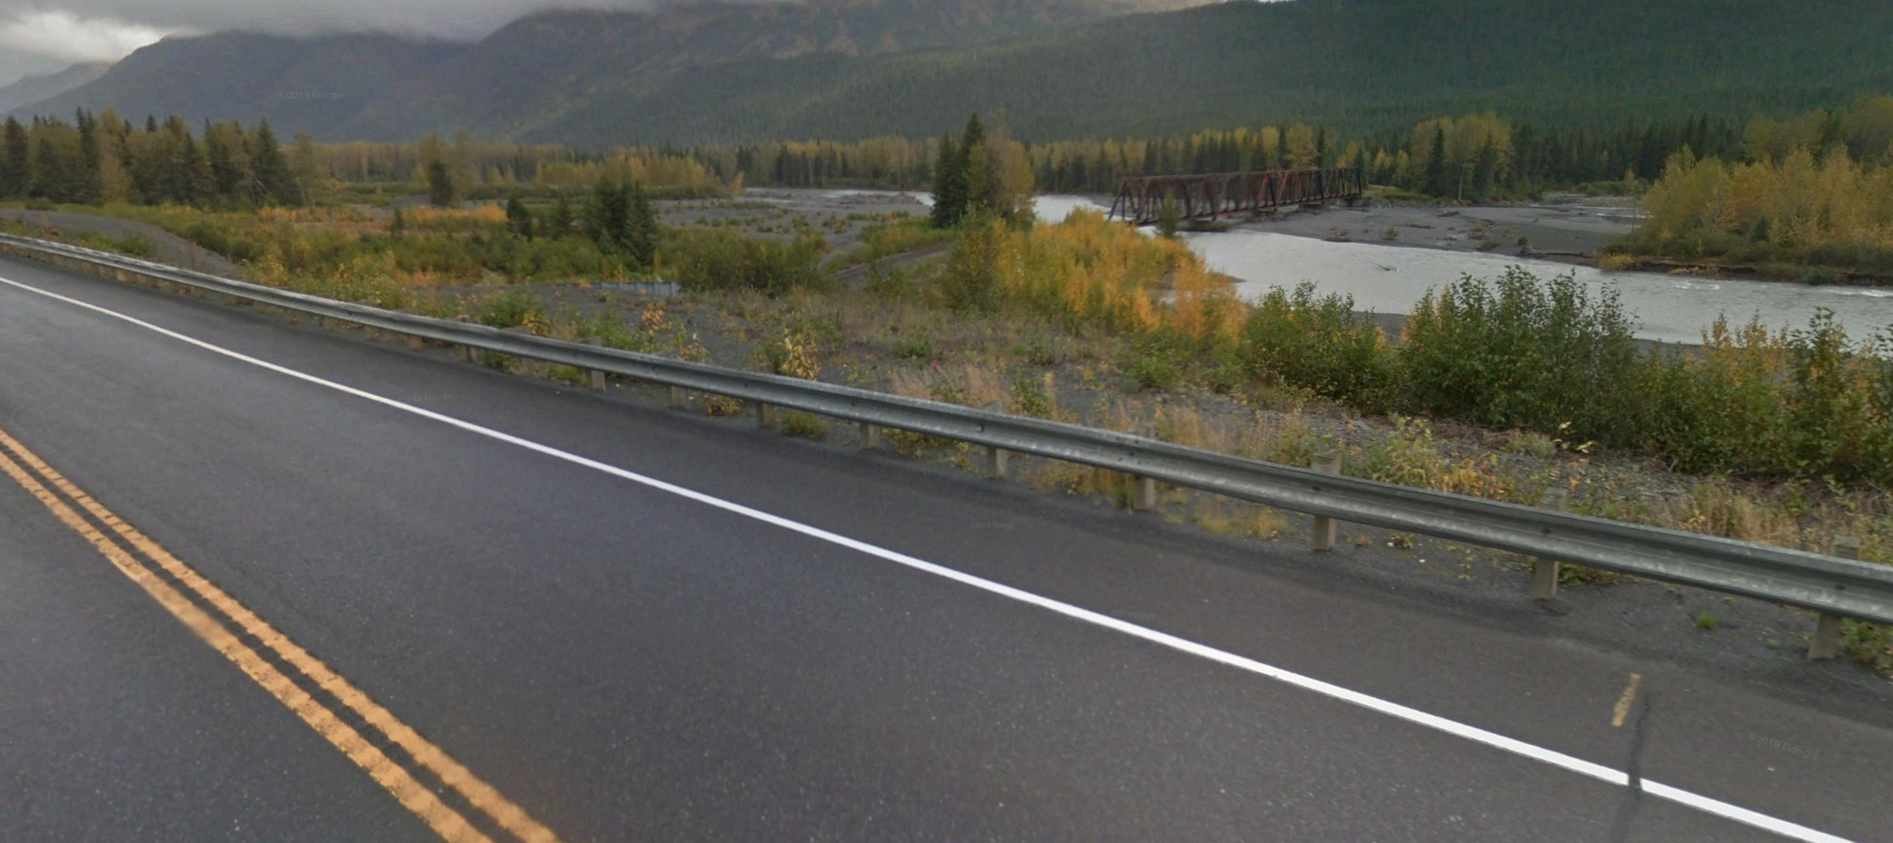
Why This Project?
The Alaska Railroad Corporation is raising its tracks, so the road must be raised.
Project Area
Notes:
Greg

Slide 8
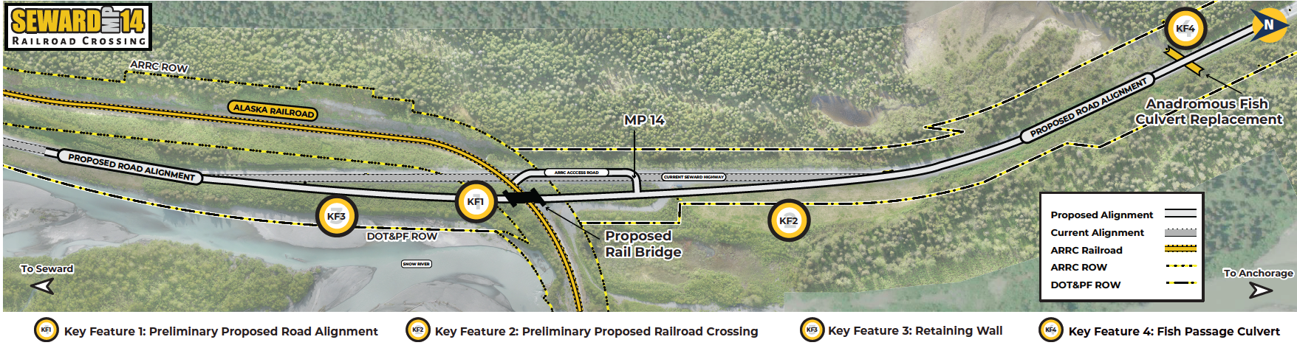
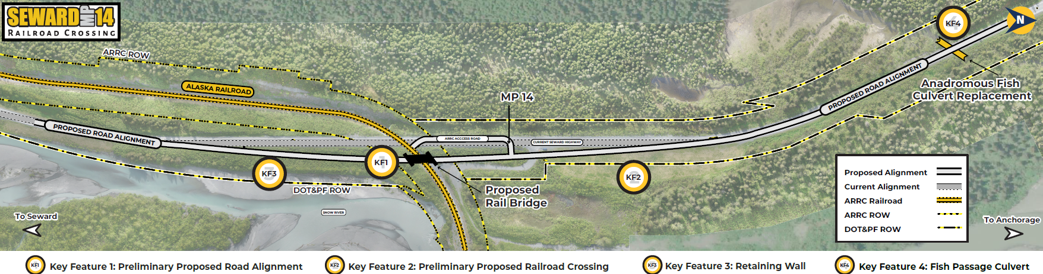
What are we doing?
Shifting alignment
Replacing tunnel with a bridge
Replacing culverts
Building a retaining wall
Notes:
Donald
Use laser pointer
- Access to river / shifting ARRC access

Slide 9
How are we doing it?
Construct new road and bridge
Transition traffic from old road to new road during night work
Decommission old road
Notes:
Donald

Slide 10
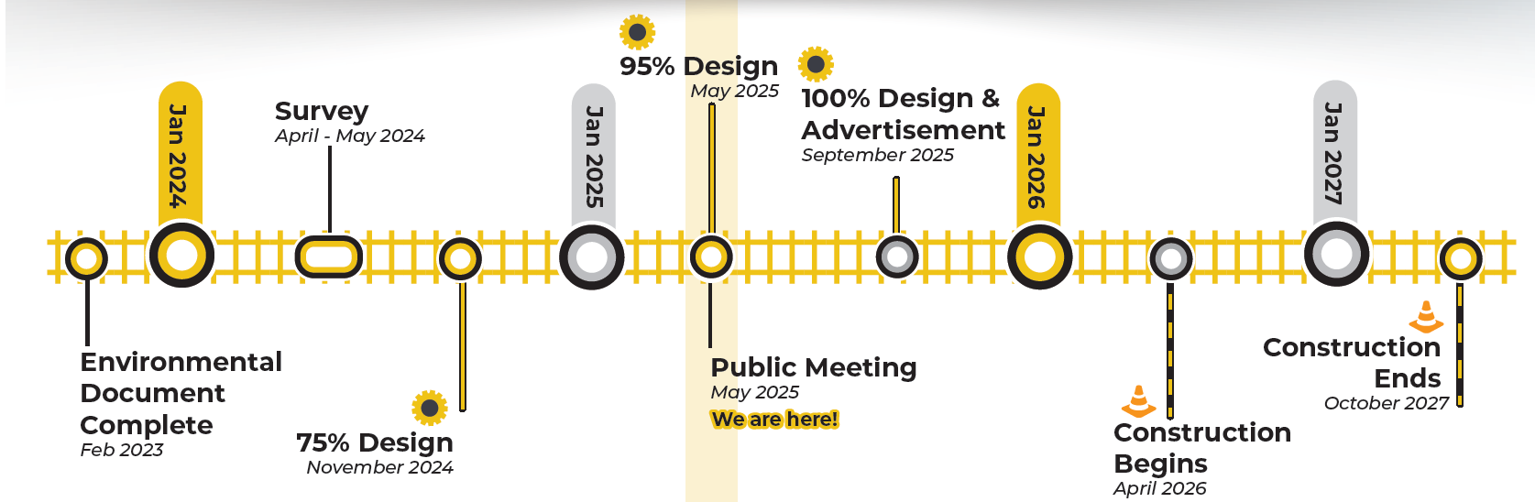
When are we doing it?
Dates are subject to change.
Notes:
Greg

Slide 11



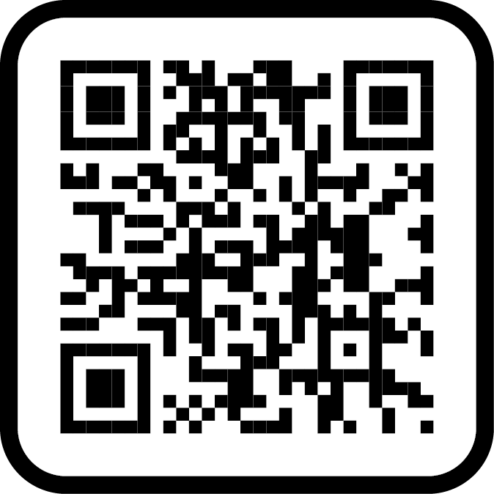
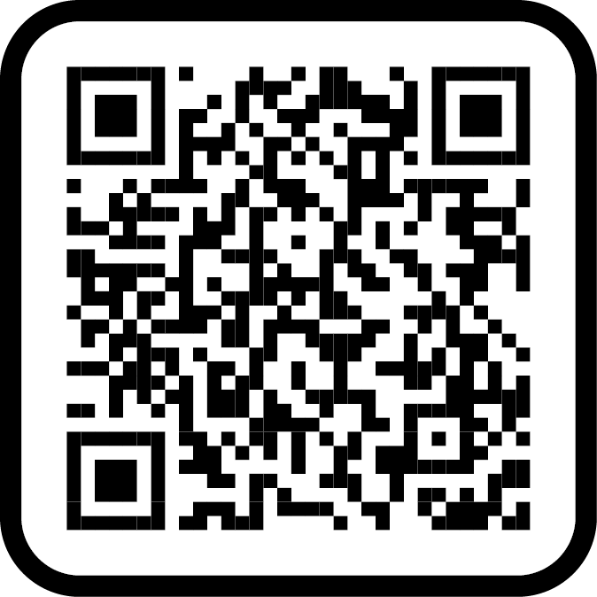
Contact Us
Rori Van Nortwick, P.E.
DOT&PF Project Manager
(907) 269-0587
Pearl-Grace Pantaleone
Public Involvement Lead
HDR, Inc.
(907) 519-2988
linktr.ee/sewardmp14
info@sewardmp14.com
Notes:
Rori – thanks for all coming!
Pearl-Grace: introduce poster session + roll plot with project staff for 1-1 Q/A until 7pm.

